Slide 1
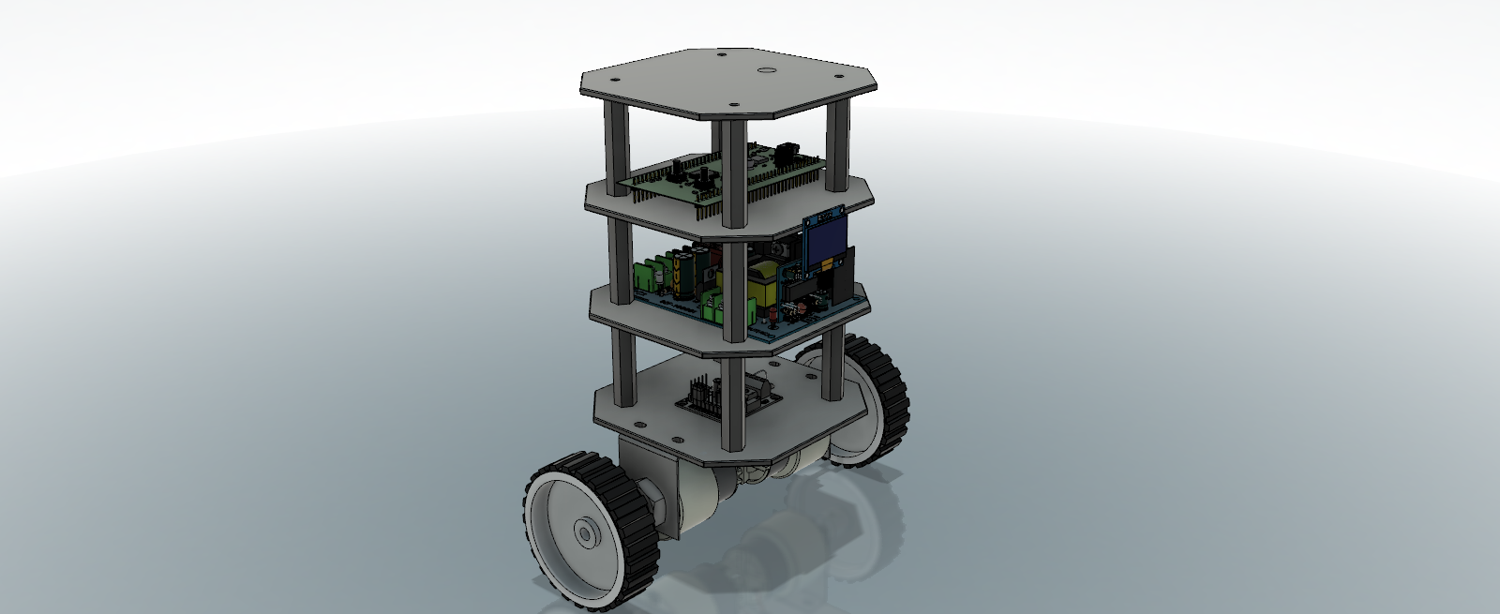
Mealy
A self –balancing Robot

Slide 2
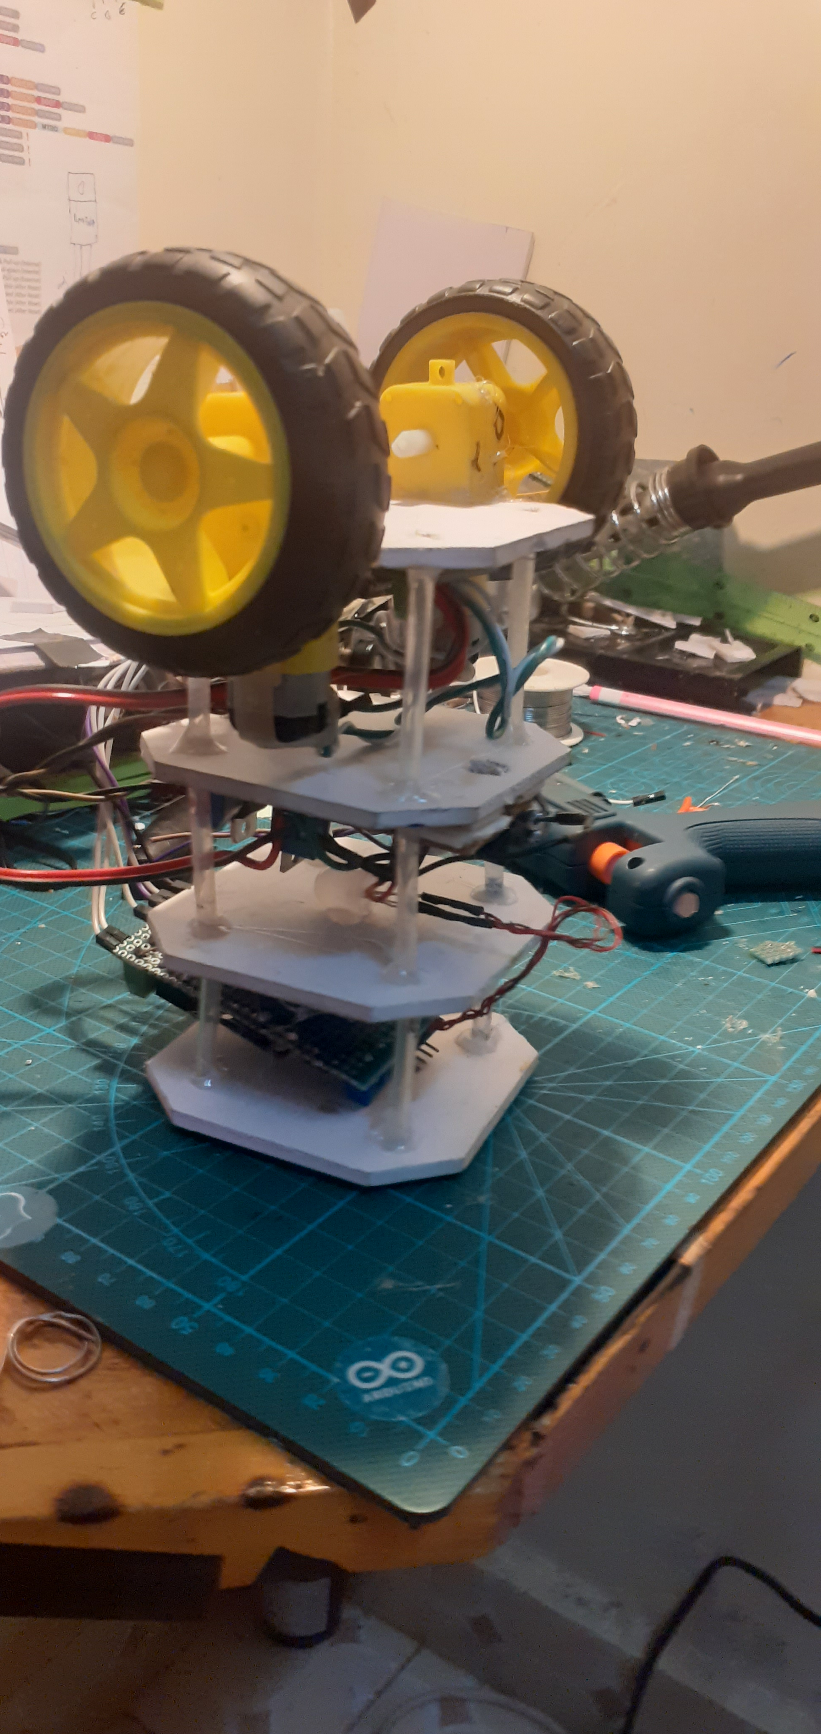
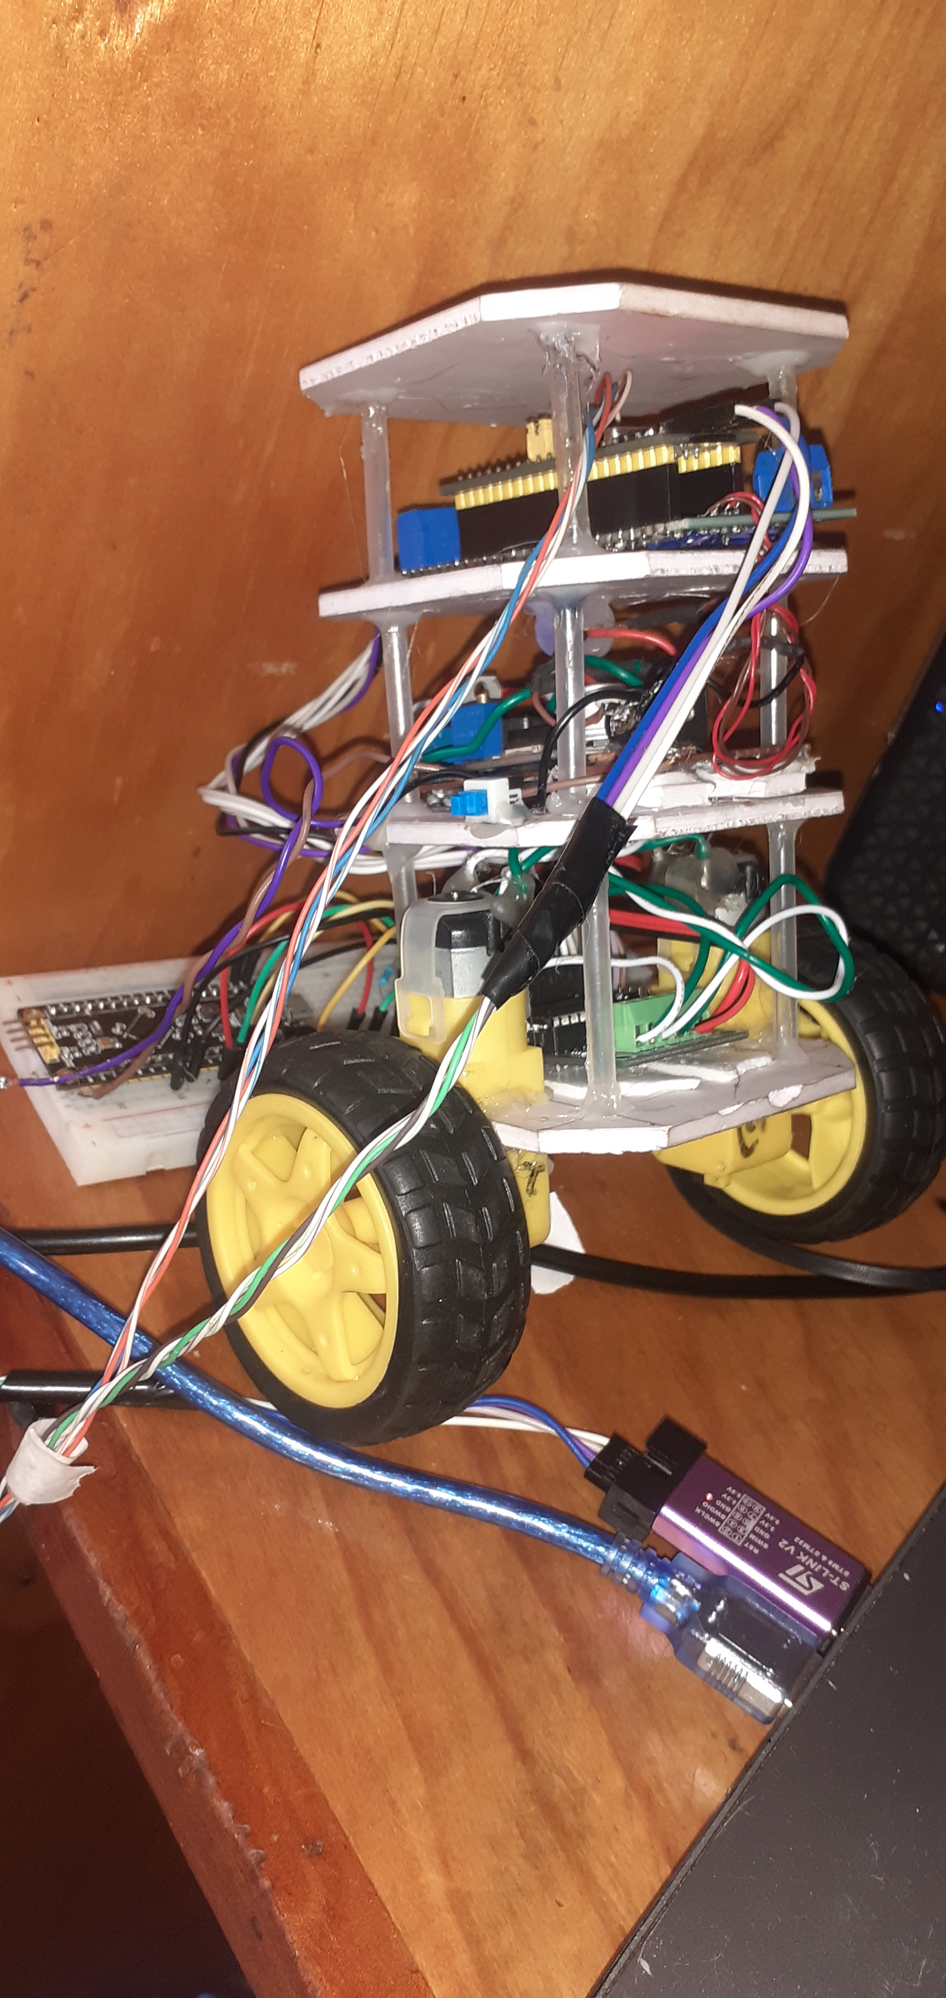
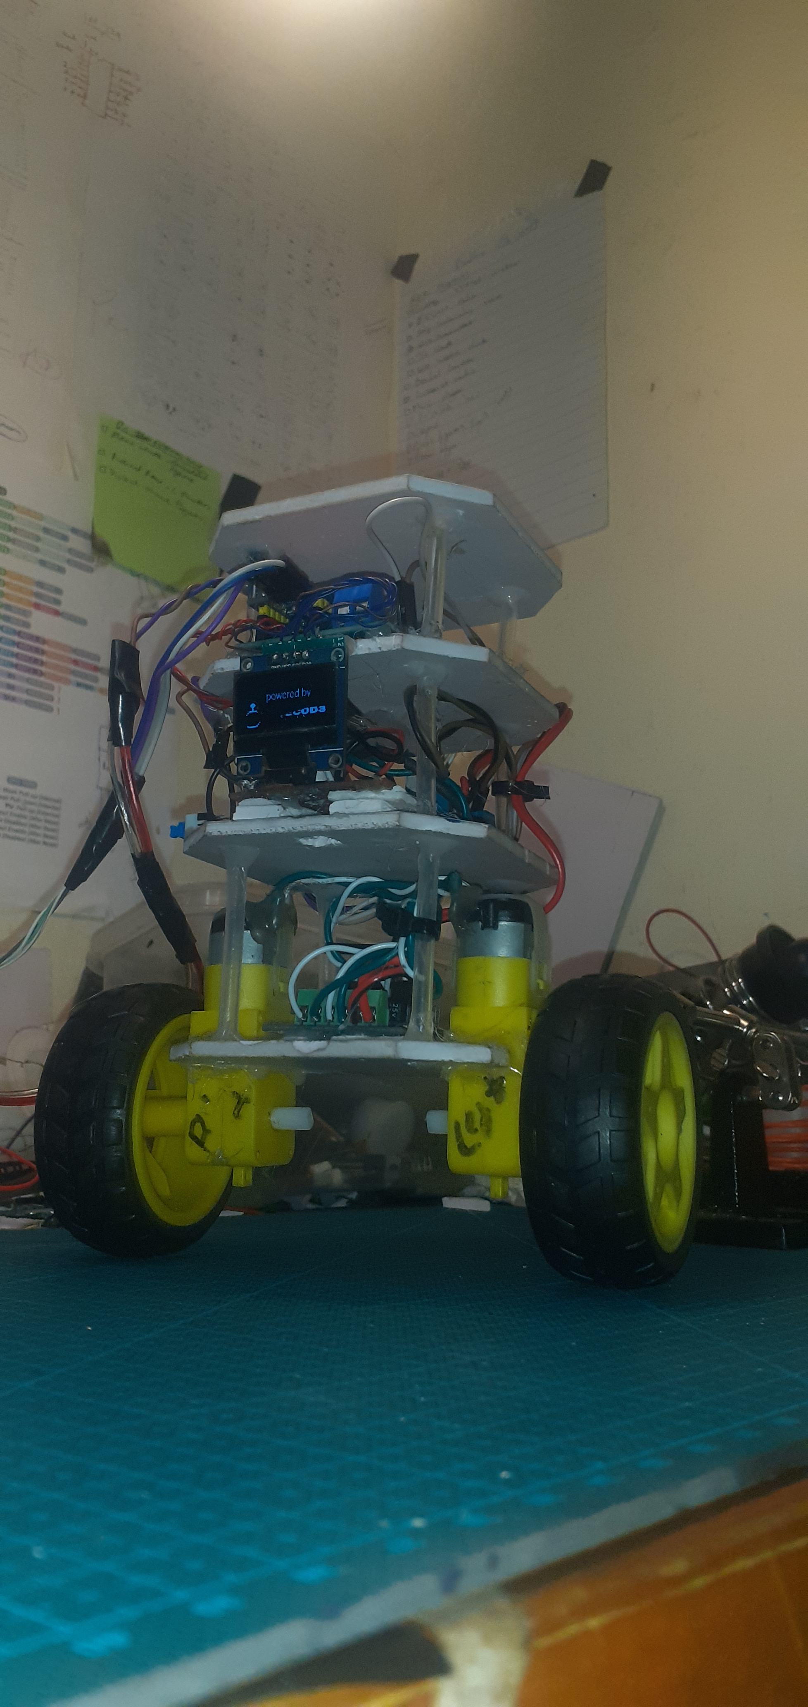
Some pictures…

Slide 3
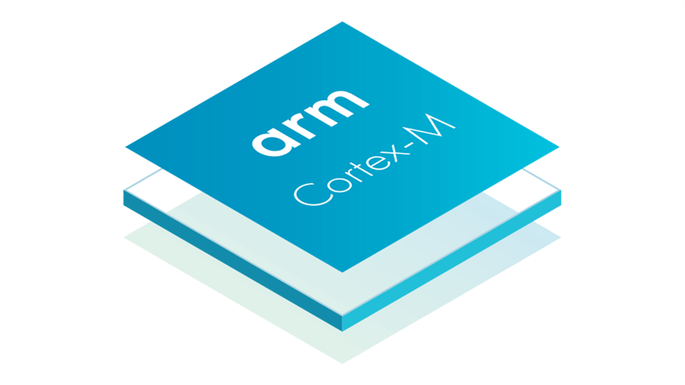
Motivation
- STM32
- PID
- Robot with STM32

Slide 4
Components
- MCU
- IMU
- Motors
- Motor driver
- Control Algorithm
- Filter
- Misc – RGB, OLED

Slide 5
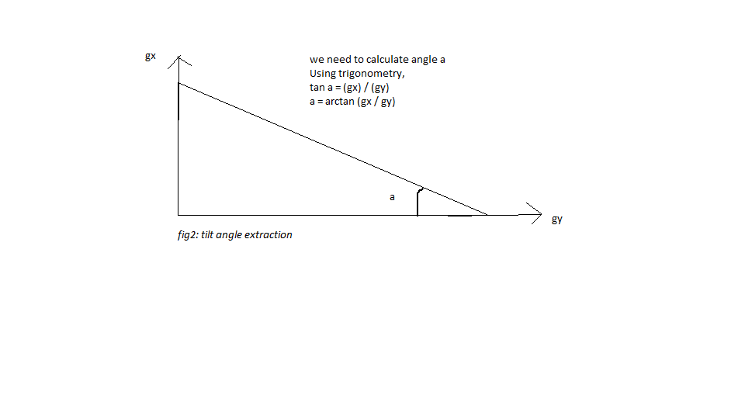
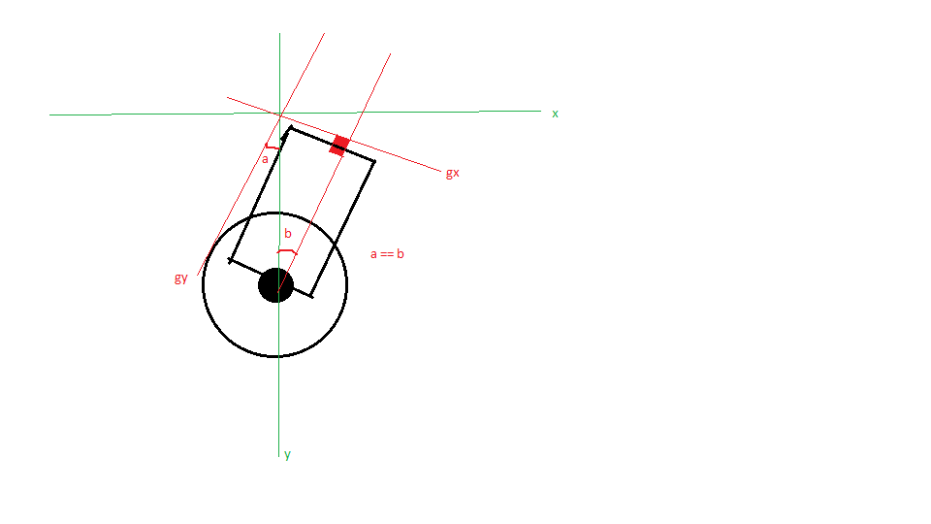
Tilt angles

Slide 6
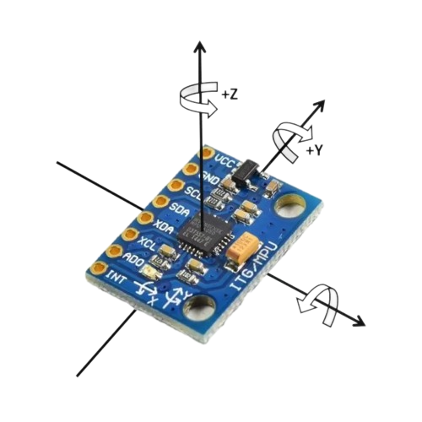
IMU
- MPU 6050
3-axis gyroscope and a
3-axis accelerometer on the
same silicon die, together with
an onboard
Digital Motion Processor™ (DMP™), which processes complex 6-axis MotionFusion algorithms.

Slide 7
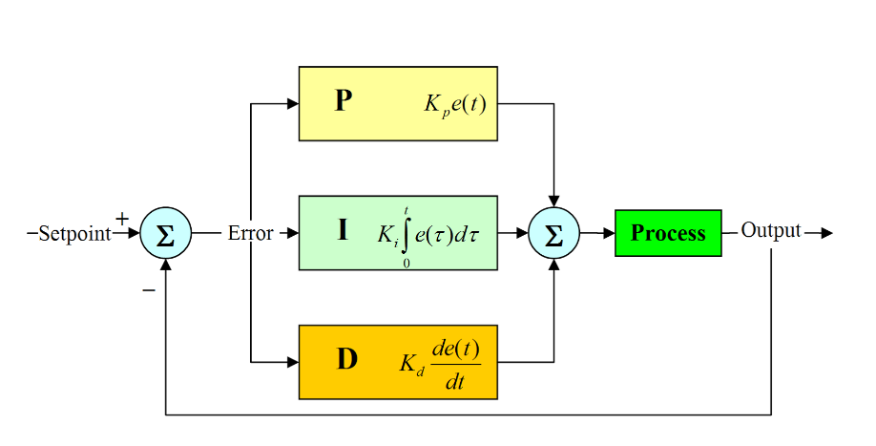
PID
- Proportional Integral Derivative

Slide 8
What about STM32?
- Powerful – 32bit
- Drivers? You have to build your own drivers
- Comparison with Arduino – 8-bit
- You have access to “almost” every bit of the MCU –clocks, Comms protocols, Timers e.t.c

Slide 9
RGB
- just for aesthetics
- Again – a driver for everything – or rather a library

Slide 10
OLED
- 0.96” Oled screen
- Custom Splash screen with PhotoPea

Slide 11
Useful Links
Github : https://github.com/bytecod3/Mealy
Photopea: https://www.photopea.com/
Complementary filter: https://vanhunteradams.com/Pico/ReactionWheel/Complementary_Filters.html
PID: https://www.ni.com/en/shop/labview/pid-theory-explained.html
STM32: https://www.st.com/en/microcontrollers-microprocessors/stm32-32-bit-arm-cortex-mcus.html
ARM architecture: https://www.arm.com/

